Slide 1
Pose-Triggered Alarm System using Computer Vision and Machine Learning
(BTech AI&DS Final Presentation A.Y. 2024-2025)
Presented by : Neeraj Pawar(A004), Bindi Gondalia(A005), Palak Singh(A033)
Under the guidance of : Prof. Shailendra Aote

Slide 2
Problem Statement
Traditional alarm clocks often fail to effectively wake users, leading to reliance on the snooze button and poor morning habits. This disrupts sleep cycles and affects mental and physical well-being. There is a need for an innovative solution that not only wakes users but also promotes physical activity and overall alertness from the moment they wake up.

Slide 3
Motivation
Health & Wellness: Encourages physical activity in the morning to improve alertness and promote a healthier start to the day.
User-Engagement: Incorporates interactive gestures and feedback, ensuring users actively participate in their wake-up routine.
Problem-Solving: Addresses the common issue of disrupted sleep cycles and ineffective alarms by requiring users to perform physical actions to deactivate the alarm.

Slide 4
Scope of the project
Pose Detection
Physical Interaction
Kalman Filter Integration
Minimal Hardware Requirement
Real-Time Feedback

Slide 5
Introduction
Many people struggle to wake up due to ineffective alarms.
Traditional alarms lead to dependency on the snooze button.
Yoga promotes physical and mental well-being through body movements.
Pose-activated alarm system blends yoga and technology for a healthy wake-up.
Objective: Encourage users to practice yoga in the morning to improve health and clarity.

Slide 6
Literature Review
Study | Description
Pose-Triggered Alarm System for Yoga-Based Movements | Utilizes MediaPipe Pose and MoveNet for real-time pose detection with Kalman filters for stability. Tested on yoga poses, achieving 99.5% accuracy; users reported 85% effectiveness in enhancing routines. Limited by single-camera 2D tracking.
Real-Time Pose Detection for Tele-Rehabilitation | Uses 3D pose estimation in virtual environments to provide feedback based on pose similarity. Effective in controlled settings for remote physiotherapy but faces challenges in multi-person scenarios and high computational requirements.
Improved Yoga Pose Detection with MediaPipe and MoveNet | Integrates MediaPipe with XgBoost classifiers to improve detection accuracy and latency, achieving 99.5% accuracy on common yoga poses, optimized for mobile applications. Faces challenges with misalignments in varied body types.
Pose Detection and Angle-Based Counting Mechanism for Interactive Alarms | Employs angle-based tracking and a counting mechanism for arm-raising actions, achieving 98% reliability. Effective in real-time detection for alarm deactivation, though accuracy may drop if movements are obstructed.
Multi-Person Pose Estimation using DeepCut | Implements DeepCut for multi-person pose estimation with optimization techniques for minimal accuracy loss. Suitable for group activities, achieving reliable tracking in fitness and sports settings, though accuracy drops with high overlap between individuals.

Slide 7
Proposed System
Pose Detection & Preprocessing | Sources: Capture real-time video from a webcam or smartphone camera. Preprocessing: Convert frames to RGB format, resize for consistent input size. Normalization: Standardize image data for accurate pose estimation.
MediaPipe for Pose Estimation | Pose Detection: Utilize MediaPipe to detect key body landmarks (shoulders, elbows, hips). Landmark Filtering: Apply Kalman Filter to reduce noise and improve accuracy of detected landmarks.
Gesture Recognition & Counting | Angle Calculation: Measure angles between key body parts (shoulder, elbow, hip) for arm gestures. Counting: Track correct arm raises; increment counter upon each valid gesture.
Alarm Deactivation Logic | Threshold Setting: Set a required count (e.g., 10 arm raises) to stop the alarm. Deactivation: Alarm stops when both arms reach the set gesture count.
Technology Stack | MediaPipe for pose estimation. OpenCV for image processing. Kalman Filter for landmark smoothing. Python for integration and logic implementation.

Slide 8
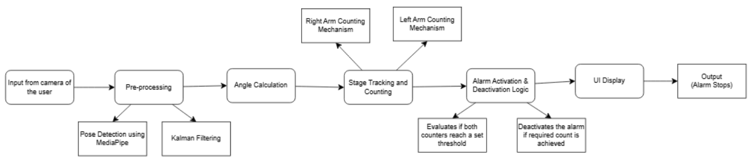
Design Diagrams

Slide 9
Implementation
GPU Verification | Ensured GPU availability for efficient pose detection and frame processing.
MediaPipe for Pose Estimation | Model Setup: Integrated the MediaPipe Pose module for real-time body landmark detection. Pose Landmark Configuration: Customized landmark tracking for shoulders, elbows, and hips to calculate arm raise angles.
Data and Model Configuration | Camera Input: Used a webcam for video capture, adjusting resolution to maintain real-time performance. Pose Tracking Configuration: Set up parameters for pose estimation (min detection confidence, min tracking confidence).
Gesture Recognition Parameters | Angle Thresholds: Defined angles (e.g., >90° for arm raises) to detect valid gestures. Arm Raise Count: Implemented a counter to track successful arm raises for deactivation. Kalman Filter: Applied Kalman Filter to smooth and enhance landmark positions.

Slide 10
Implementation
System Logic | Counting Logic: Developed algorithm to increment counters when valid gestures are detected. Deactivation Threshold: Set alarm deactivation condition to require 10 successful arm raises for both arms.
Performance Optimization | Real-Time Processing: Optimized the system to process frames at 30 FPS for smooth user interaction. Visualization: Displayed real-time feedback on the screen, showing the angle and gesture counts.

Slide 11
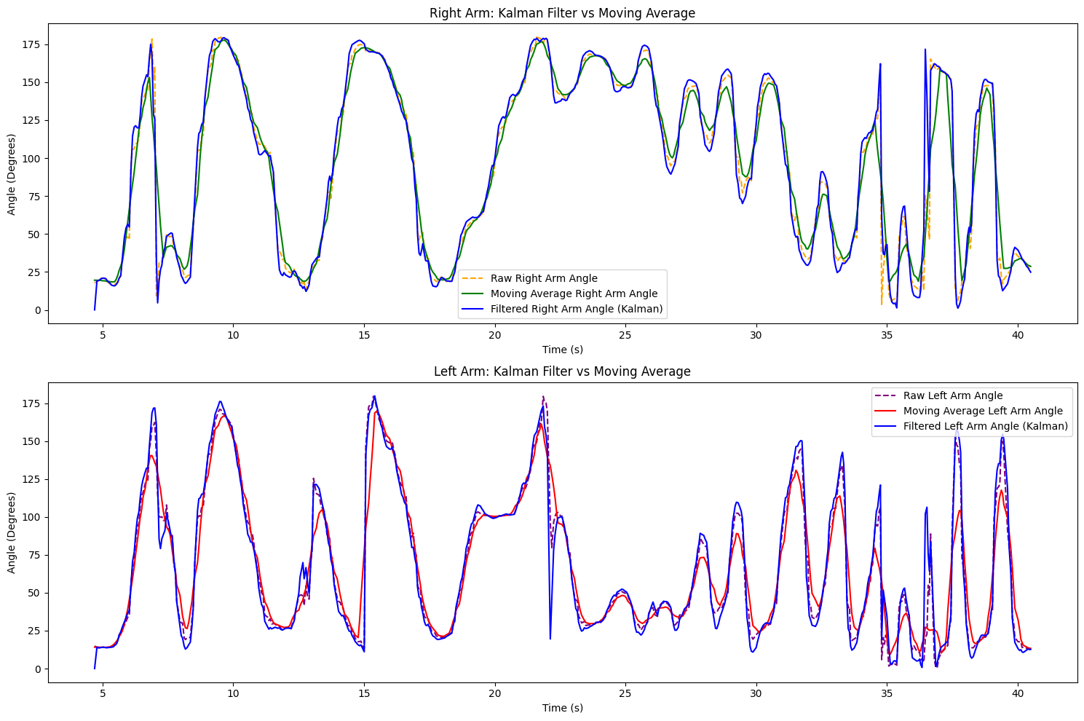
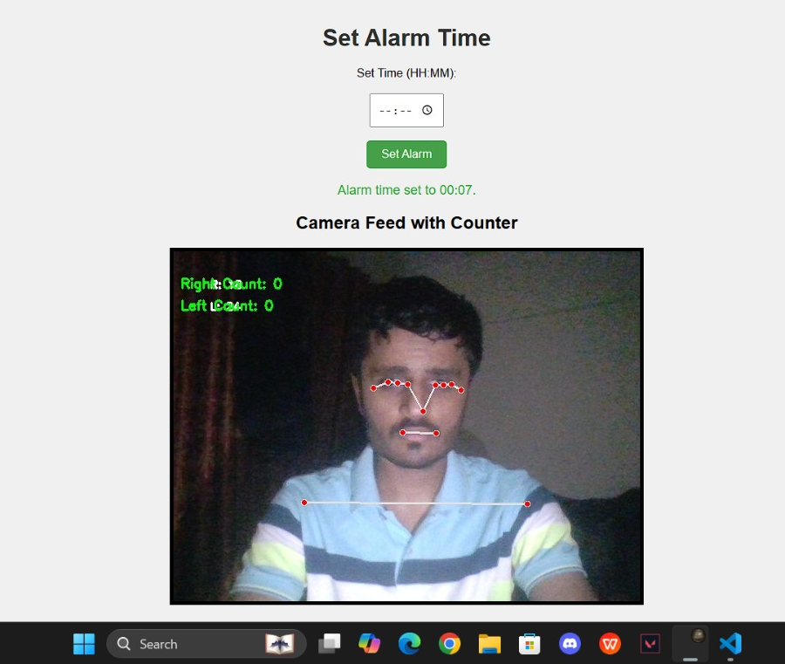
Results

Slide 12
Paper Details
Submitted in International Conference on Innovation in Computing and Engineering 2025(ICE 2025)
Author notification: 30th Nov
Submitted in 2nd IEEE international conference on AI and Quantam Computation-Based Sensor Applications (ICAIQSA-2024)
Author notification: Before 16th Nov

Slide 13
References
1. Deep High Resolution Representation Learning for Human Pose Estimation
2. Improved Yoga Pose Detection Using MediaPipe and MoveNet in a DL model
3. Yoga Pose Detection and Classification using DL
4. APPLICATIONS OF GOOGLE MEDIAPIPE POSE ESTIMATION
5. Real-Time Yoga Pose Detection using ML algo
6. A Kalman-Filter Based Method for Pose estimation in Visual Servoing
7. Introduction to estimation and the Kalman Filter
8. Real-time human pose detection and tracking for tele-rehabilitation in virtual reality
9. Grasp Pose Detection with Affordance-based Task Constraint Learning in single view point clouds
10. National Sleep Foundation’s sleep time duration recommendations
11. An Introduction to the Kalman Filter

Slide 14
References
12. MediaPipe A Framework for Building Perception Pipelines
13. Pose Estimation from Corresponding Point Data
14. Deep Learning-Based Human Pose EstimationA Survey
15. DeeperCut A Deeper, Stronger, and Faster Multi-person Pose Estimation Model

